Slide 1
Introduction to Information Security
Firewalls

Slide 2
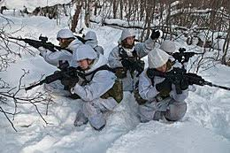
What is a Firewall?
A point of control and monitoring
Imposes restrictions on network services
only authorized traffic is allowed
Controlling access
can implement alarms for abnormal behavior
A firewall is a security policy enforcement point that regulates access between computer networks
Controls TCP protocols
http, smtp, ftp, telnet etc

Slide 3
What do Firewalls Protect?
Data
Financial information
Sensitive employee or customer data
Resources
Computing resources
Time resources
Reputation
Loss of confidence in an organization
Intruder uses an organization’s network to attack other sites

Slide 4
Who do Firewalls Guard Against?
Internal Users
Hackers
block unauthorized access to networks and systems by filtering incoming and outgoing traffic,
Corporate Espionage
obtain confidential business information to gain a competitive advantage
Terrorists
Common Thieves
prevent malicious individuals from exploiting vulnerabilities

Slide 5
Common Internet Threats
Denial of service attacks
Specific attacks that can cause a server crash
Flooding the server with traffic to disrupt or deny service
Intrusion threats
Attacks on services
The backend server may not be enough for adequate protection, but the firewall can block external attacks
Notes:
Web defacement is an attack in which malicious parties penetrate a website and replace content on the site with their own messages.

Slide 6
How Vulnerable are Internet Services?
E-mail or smtp – Simple Mail Transfer Protocol
Risks Include
E-mail bombing (stalking)
Anonymous harassment
Large amounts of e-mail to a single user address
Spamming
Messages sent to numerous different users from a host
Virus download mechanism

Slide 7
How Vulnerable are Internet Services?
FTP - File Transfer Protocol
Risks Include
Unencrypted authentication
Usernames and passwords can be "sniffed”
Unencrypted data transfers
Data can be viewed

Slide 8
How Vulnerable are internet services?
HTTP – Hypertext Transfer Protocol
Risks Include
Browsers can be used to run dangerous commands
Difficult to secure
Remote execution of commands and execution (server side)
Notes:
Arbitrary auth of remote requests and web servers, abuse of server resources, features, and security hole exploits, pose information extraction i.e.. ip info, domain info and file info

Slide 9
How Vulnerable are Internet Services?
DNS (Domain Name System)
Risks include
DNS cache poisoning
If an attacker can inject malicious records into the cache, they can direct users to fraudulent websites.
DNS spoofing
Attacker intercepts DNS queries sent by the victim and returns malicious DNS responses, redirecting them to fake websites or to attacker-controlled servers.

Slide 10
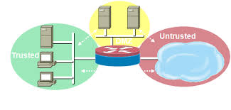
So what does a Firewall do?

Slide 11
Firewall Architecture Overview
Basic Firewall Components
Software
Hardware
Purpose Built/Appliance based
Notes:
Time For a Break!

Slide 12
Classification of Firewall
Characterized by protocol level it controls in
Packet filtering
Circuit gateways
Application gateways
Combination of above is dynamic packet filter

Slide 13
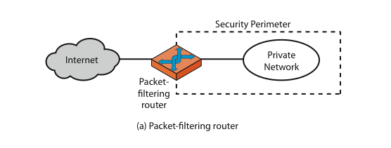
Firewalls – Packet Filters

Slide 14
Firewalls – Packet Filters
Simplest of components
Uses transport-layer information only
IP Source Address, Destination Address
Protocol/Next Header (TCP, UDP, ICMP, etc)
TCP or UDP source & destination ports
TCP Flags (SYN, ACK, FIN, RST, PSH, etc)
ICMP message type

Slide 15
Usage of Packet Filters
Filtering with incoming or outgoing interfaces
E.g., Ingress filtering of spoofed IP addresses
Egress filtering

Slide 16
Ingress Filtering
Filter malicious traffic coming from outer untrusted network (Internet).
Checking the source IP Addresses of incoming packets to prevent malicious traffic
Block packets in case if Source IP Address is:
IP Address of internal network
Loopback IP Addresses
IP addresses used by a device to send network traffic to itself. The device can communicate with itself as if it were communicating with another machine on the network
Multicast IP addresses
Allows the sender to send one copy of the data to a group of recipients
Private IP Addresses from outer network
Notes:
In computer networking, ingress filtering is a technique used to ensure that incoming packets are actually from the networks from which they claim to originate. This can be used as a countermeasure against various spoofing attacks where the attacker's packets contain fake IP addresses.

Slide 17
Egress Filtering
Monitoring and controlling the outbound malicious traffic from internal network to outer network.
Monitoring the Source IP Addresses of packets going from internal network to outer network.
If the source IP address is not in the trusted IP Address list of internal network then IP Spoofing attack is launched by some one from your internal network.
Notes:
In computer networking, egress filtering is the practice of monitoring and potentially restricting the flow of information outbound from one network to another. Typically, it is information from a private TCP/IP computer network to the Internet that is controlled.

Slide 18
Firewall Gateways
A firewall gateway is a security device or system that acts as a barrier between two or more networks, typically a private network
Filter incoming, outgoing packets
All incoming traffic directed to firewall
All outgoing traffic appears to come from firewall
Operates at the Transport Layer (Layer 4) of the OSI model
Notes:
Gateway is like a NAT box, ie, a home router.

Slide 19
Application-Level Filtering
Acts as an intermediary that filters traffic based on application-specific protocols (e.g., HTTP, FTP, SMTP, DNS).
It inspects the actual content of the data being transferred, ensuring that it matches the expected application behavior.
Operates at the Application Layer of the OSI model

Slide 20
Dynamic Packet Filter Implementation
Dynamically update packet filter’s ruleset
Rules from the rule set can be selected on conditional basis.
Uses State Table for getting information about connections between hosts.
Rules can be selected at run time.
Functionality of different layers of firewall can also be selected dynamically depending upon nature of traffic.

Slide 21
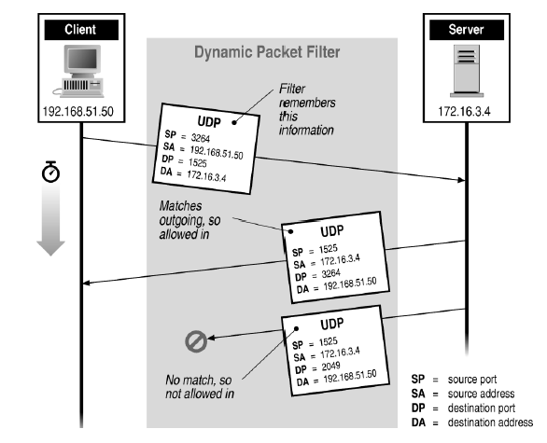
Stateful Filtering
To avoid TCP SYN flooding attacks

